Slide 1
Stage 2 Research Presentation: Consolidation of the Superannuation Industry
Marlon Ferguson

Slide 2
Data Sets
Annual APRA Data:
30/6/2004 – 30/6/2022
Split data between merged and non-merged firms
Dummy variables constructed to indicate acquiring and target fund
35 Merger observations since 2011
Quarterly APRA Data:
30/9/2013 – 30/6/2023
Split data between merged and non-merged firms
Dummy variables constructed to indicate acquiring and target fund
27 Merger observations since 2014

Slide 3
Data Processing
Annual and Quarterly data obtained from APRA
Quarterly: (9/2013 - 6/2020) & (9/2020 – 6/2023) merged
Merger List
KPMG Superannuation dashboard for merger announcements
Confirm announcement and date using company statements + news reports
Track asset flows between acquiring and target fund
RSE Wind-up date
Successor fund transfers (SFT’s)
Look at total asset growth

Slide 4
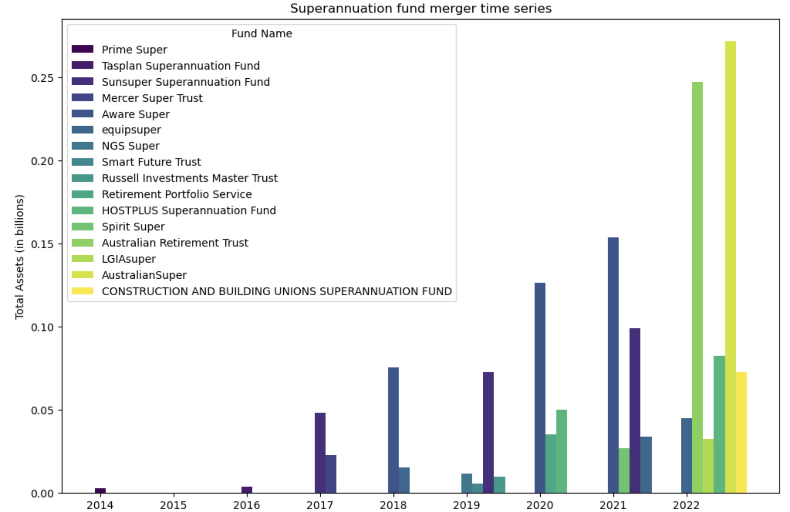
Superannuation Mergers: Total Assets

Slide 5
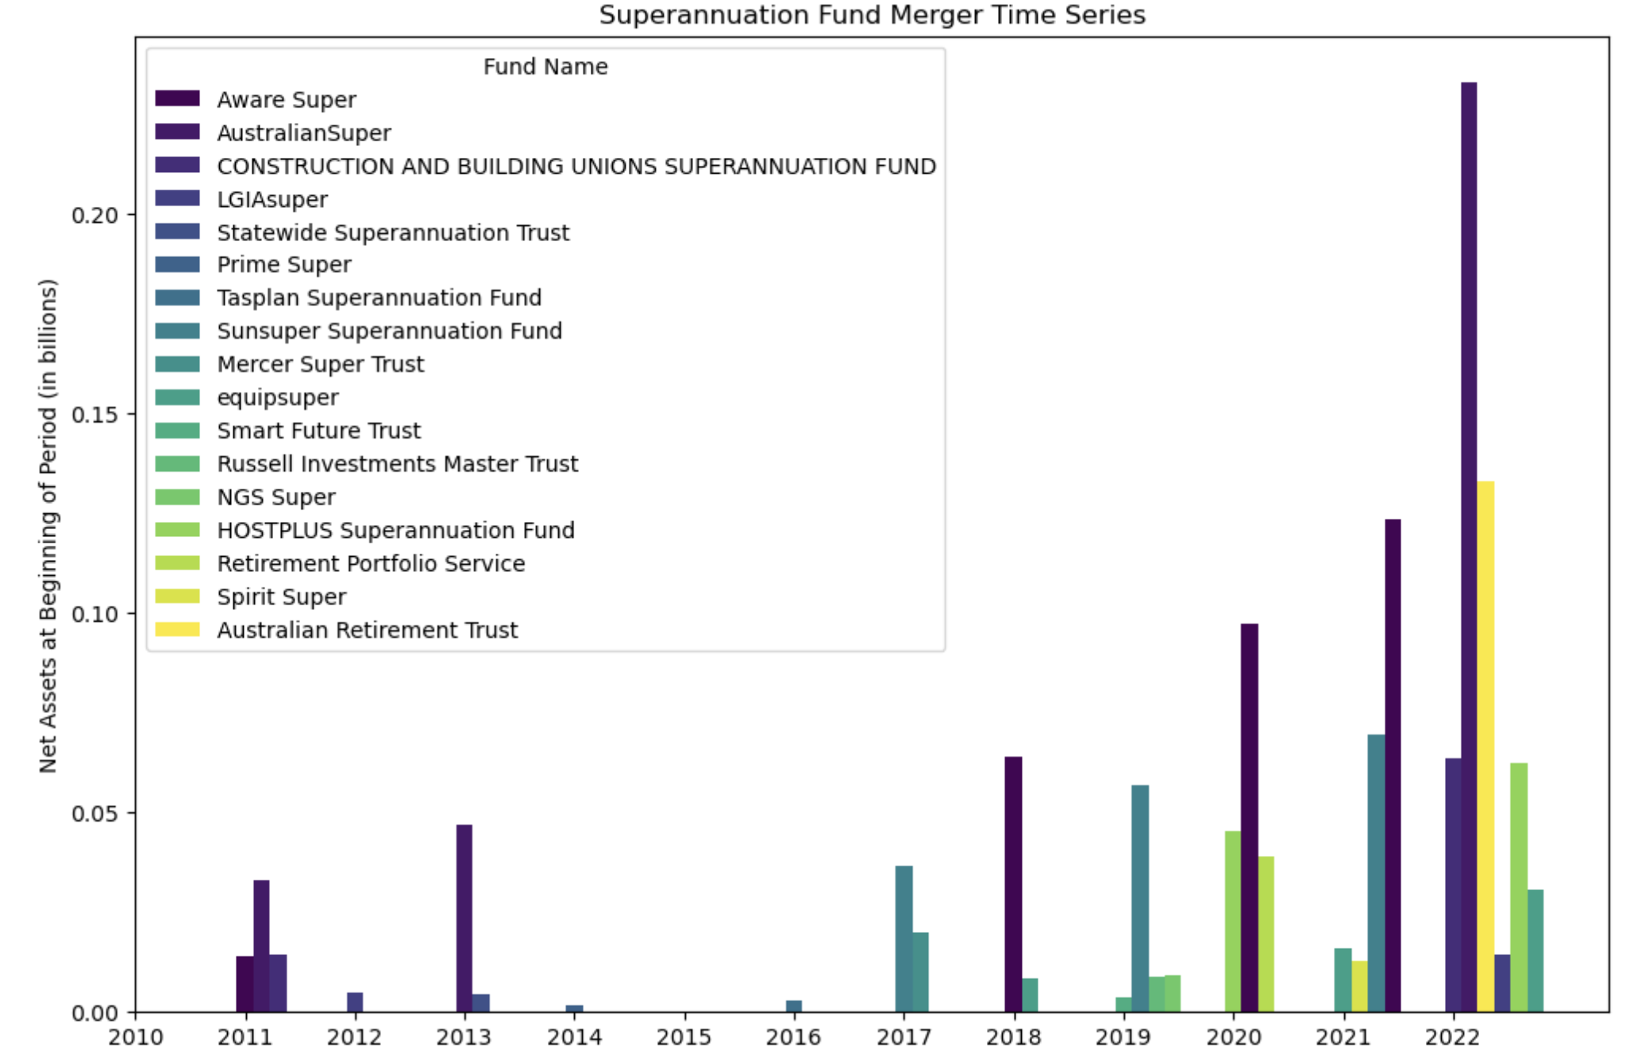
Superannuation Mergers: Net Assets

Slide 6
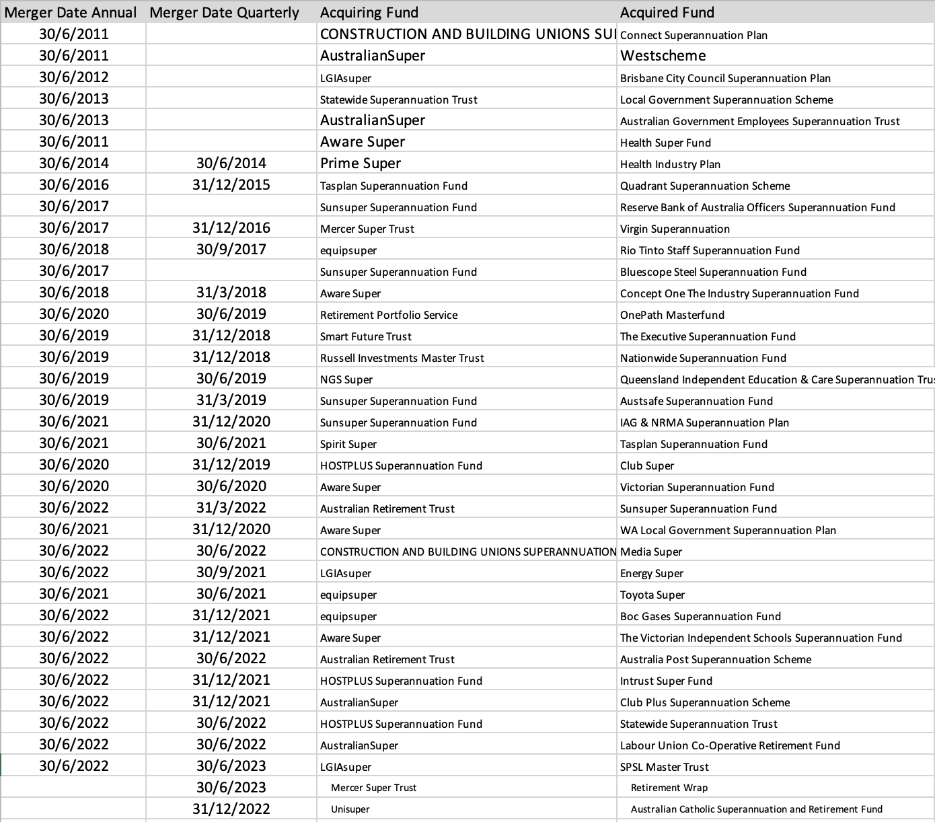

Slide 7
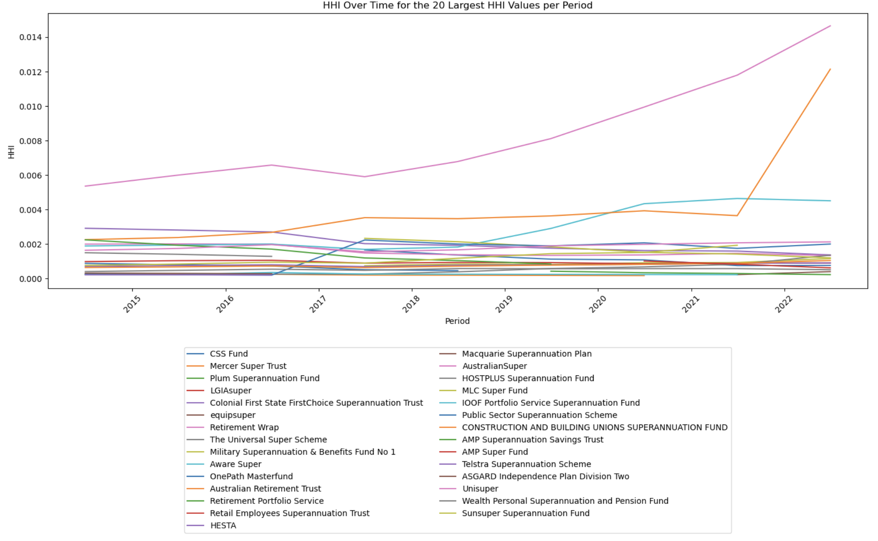
HHI Index : Total Assets

Slide 8
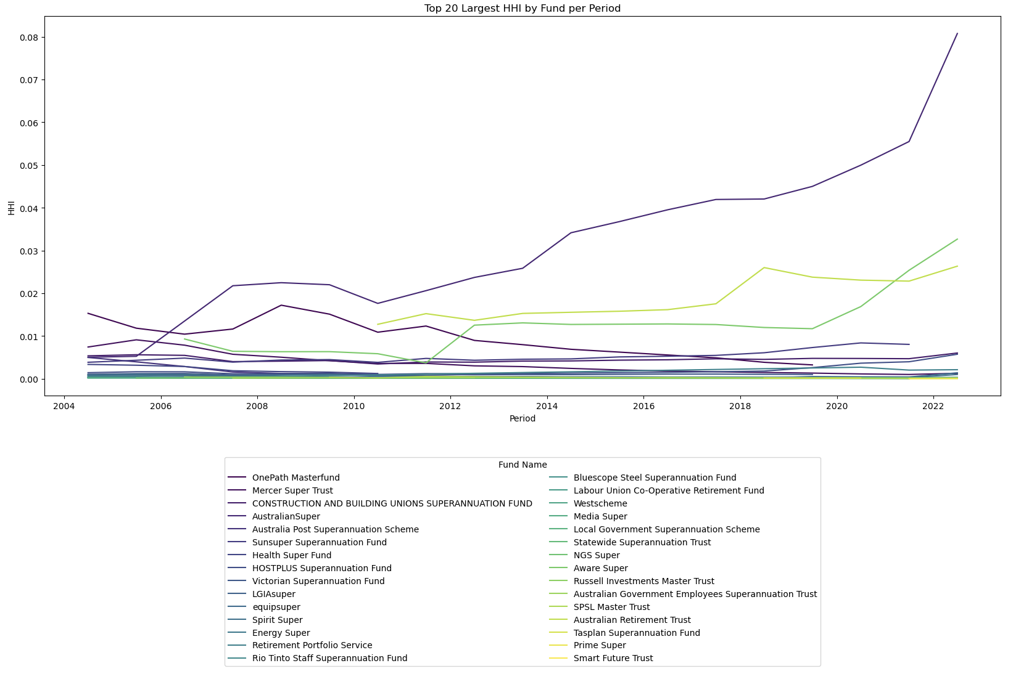
HHI Index: Net Assets

Slide 9
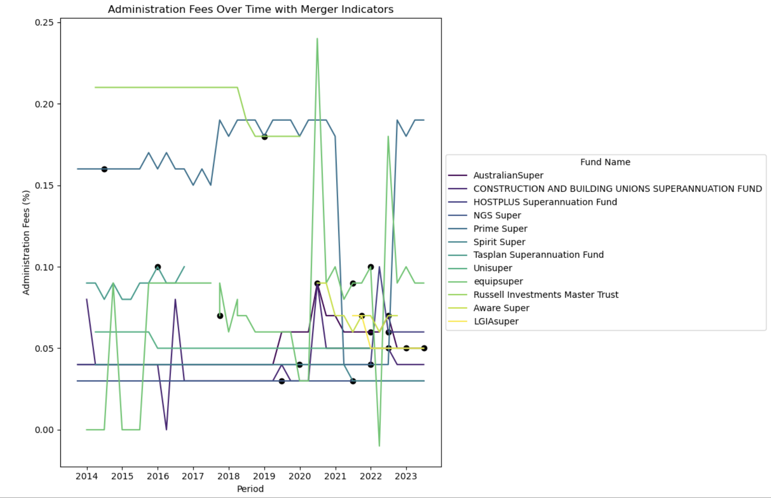
Administration Fees: Acquiring Funds

Slide 10
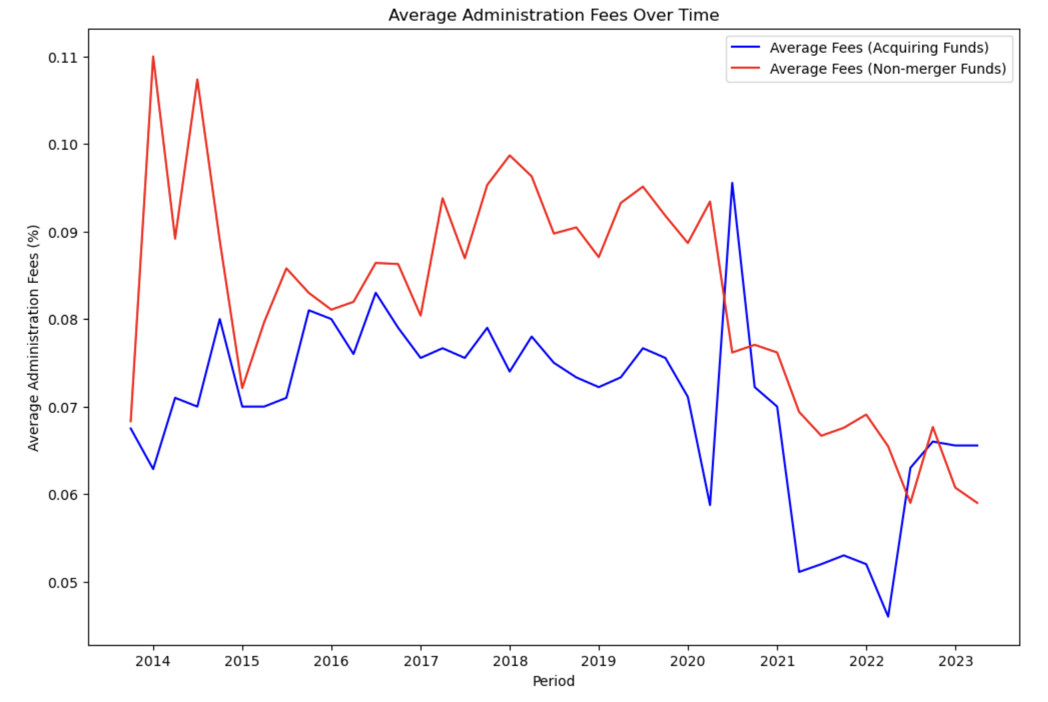
Admin Fees: Acquiring funds vs non-mergers

Slide 11
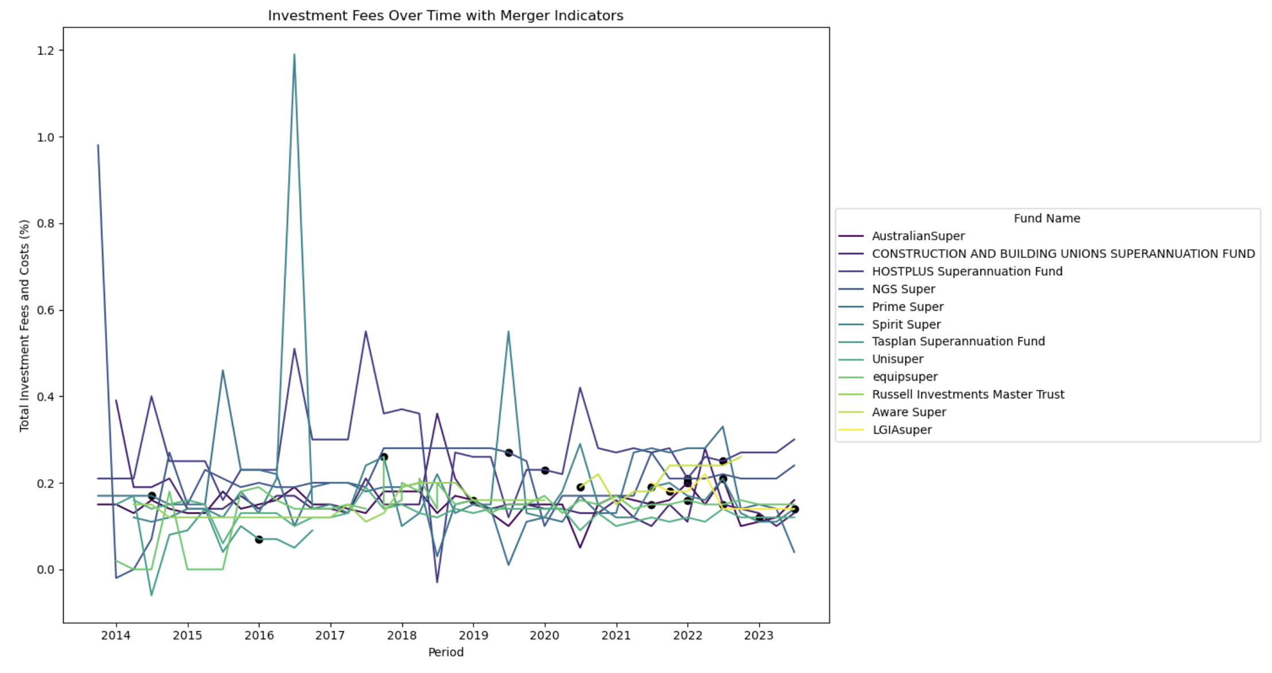
Investment Fees: Acquiring Funds

Slide 12
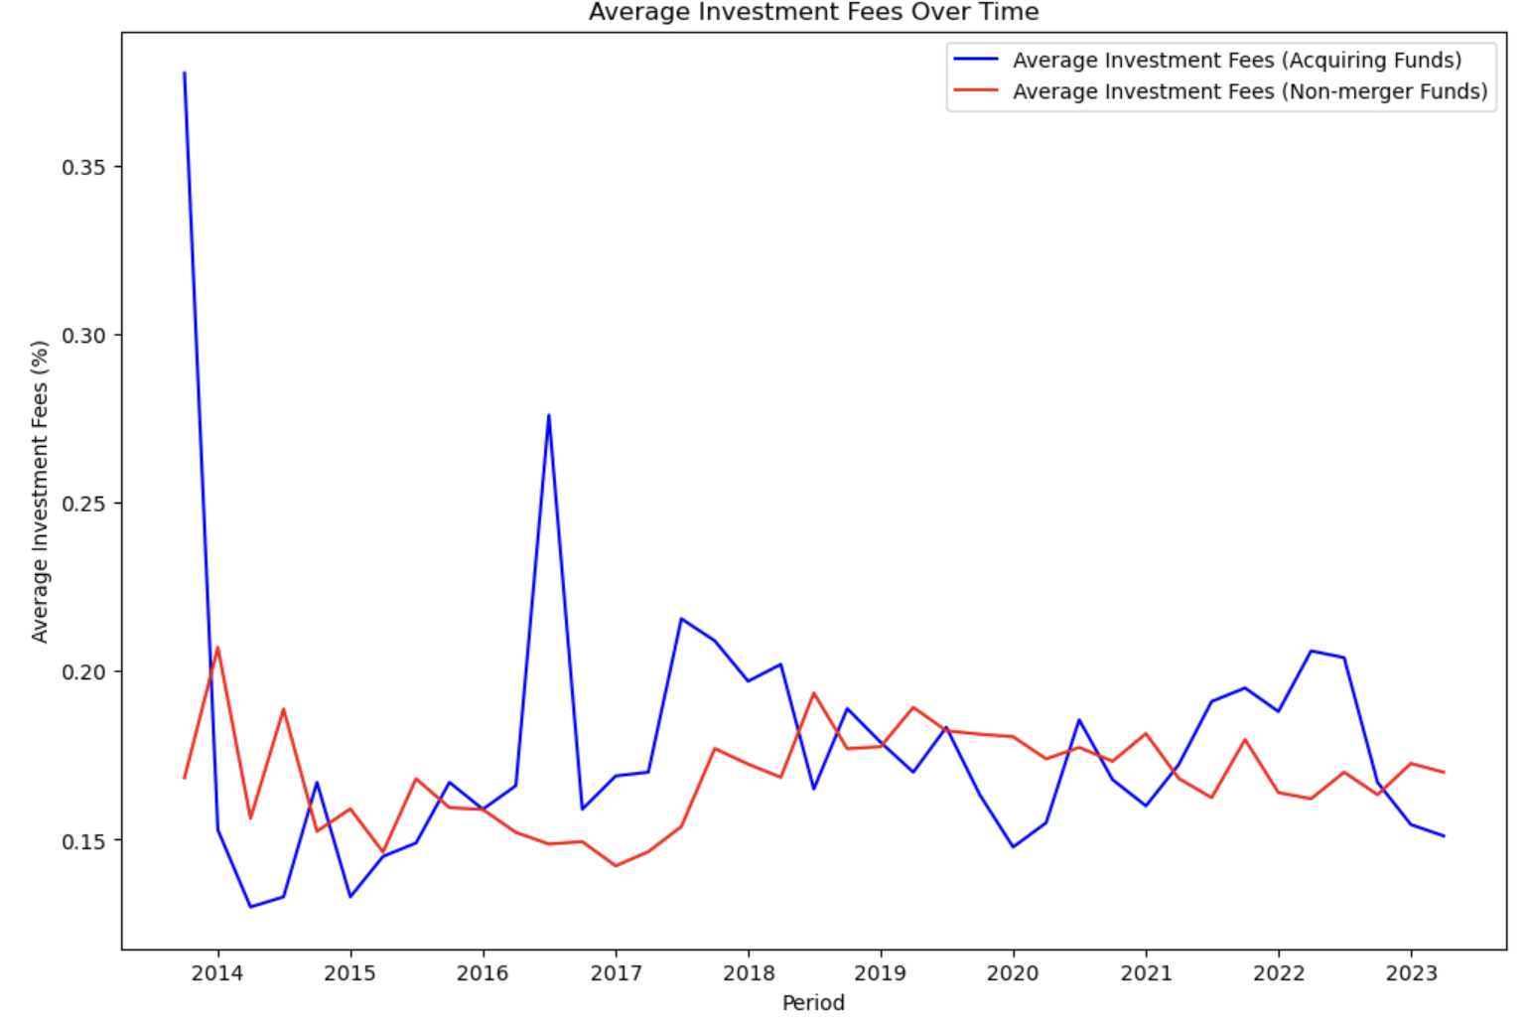
Investment fees: acquiring vs non-merger

Slide 13
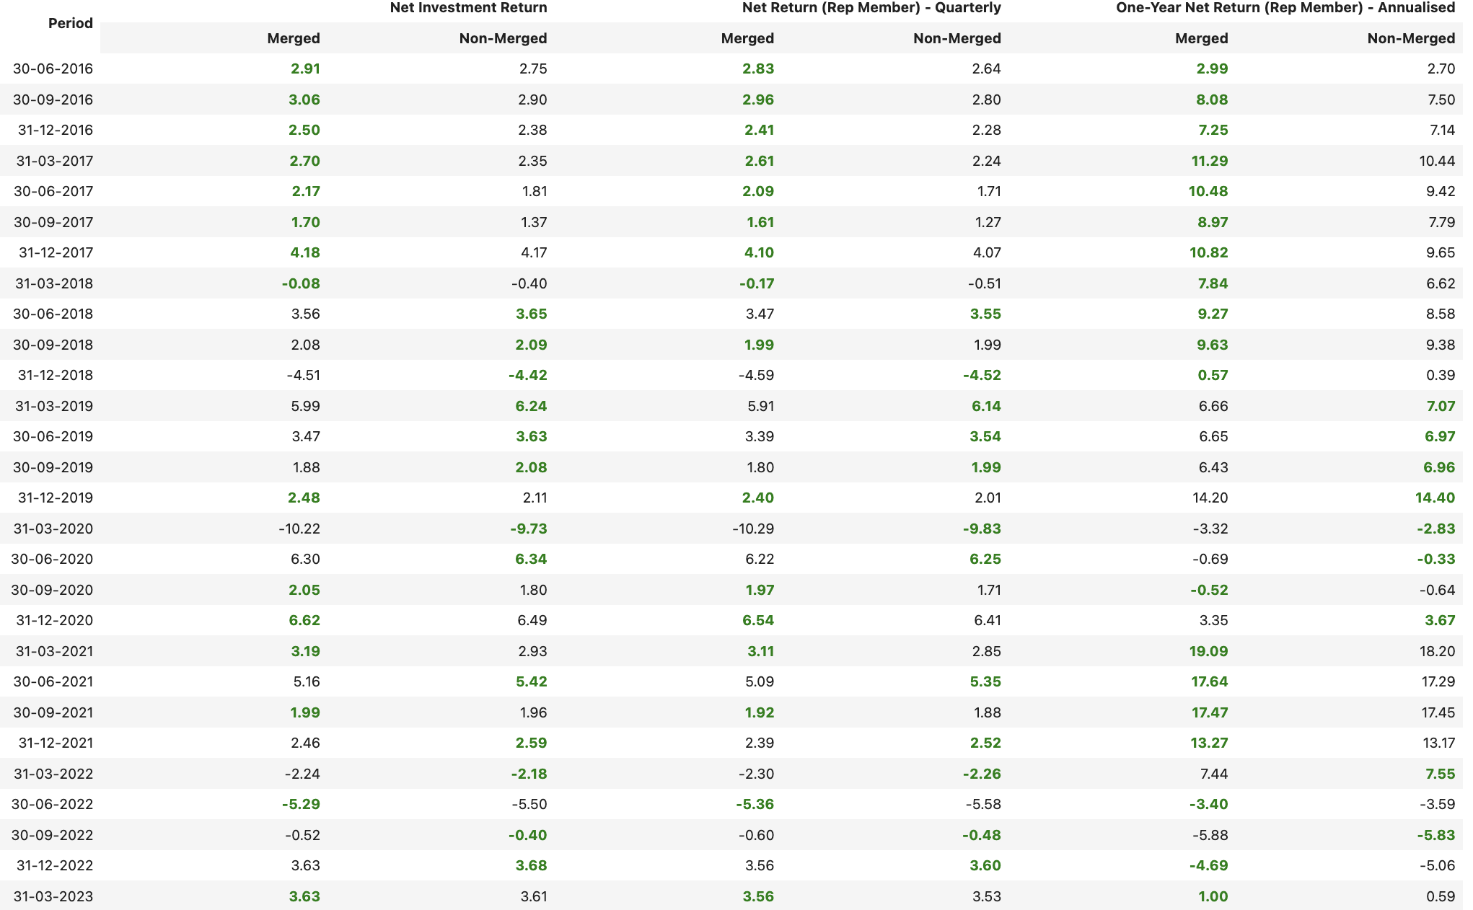

Slide 14
Model Framework
Time-series cross-sectional analysis
Event study to study mergers
Change in characteristics: fees, returns, strategic asset allocation etc
Event window (-3, +3)
Regression analysis
Study the effects of merger
Diff-in-diff

